Slide 4
Housing need: [insert location]
[your logo here]
Housing insecurity
With millions of households either directly affected by the virus or by the ripple effects of job losses and business closures, housing stability has emerged as a critical issue nation wide. High rates of pre-covid housing cost-burden show the level of pre-existing vulnerability, especially for renters.
XX%
cost burdened homeowners
XX%
cost burdened renters
Economic stability
The country has experienced its highest level of unemployment since 1948, thanks to economic fallout from the pandemic. However, local impacts have varied significantly based on preexisting levels of economic security and local job markets.
XX%
No computer device
XX%
No internet access
XX%
Rely on public transit
Access to resources
US Census ACS 2015-2019 5-year Estimates.

Slide 5
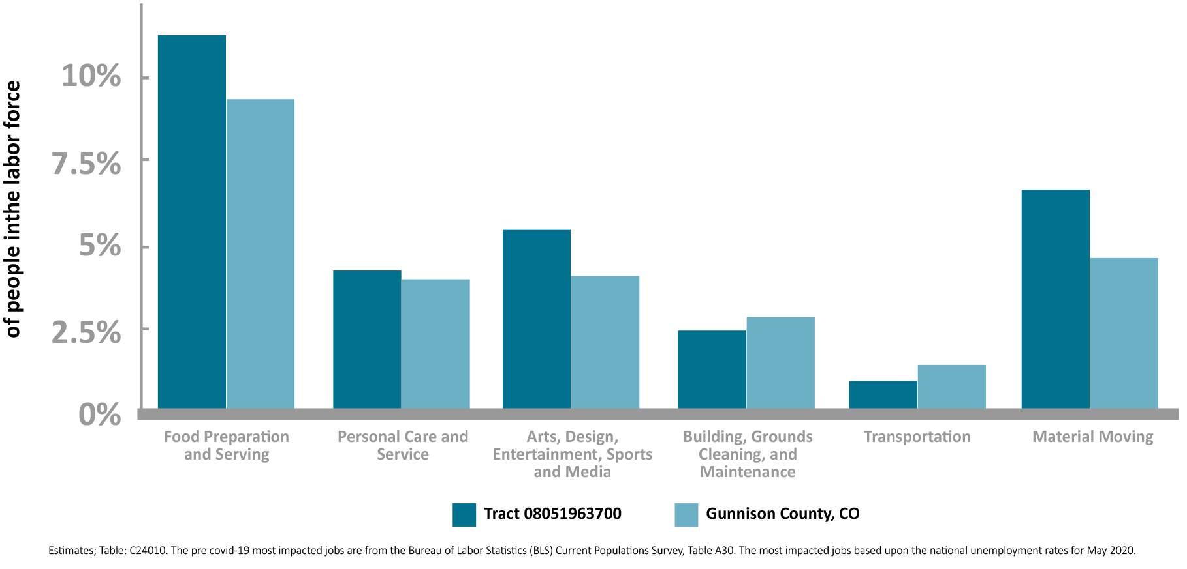
Housing need: Gunnison, CO
Housing insecurity
With millions of households either directly affected by the virus or by the ripple effects of job losses and business closures, housing stability has emerged as a critical issue nation wide. High rates of pre-covid housing cost-burden show the level of pre-existing vulnerability, especially for renters.
19%
cost burdened homeowners
51%
cost burdened renters
Pre-covid Share of Local Labor Force in Most Impacted Occupations
Economic stability
The country has experienced its highest level of unemployment since 1948, thanks to economic fallout from the pandemic. However, local impacts have varied significantly based on preexisting levels of economic security and local job markets.
3%
No computer device
6%
No internet access
8%
Rely on public transit
Access to resources
US Census ACS 2015-2019 5-year Estimates.

